Slide 1
Introduction to Discrete Probability
This lecture is mainly based on the power point slides by Professor Dan Boneh from Stanford University.
Notes:
Zili Shao

Slide 2

Discrete Probability
(crash course, cont.)
Online Cryptography Course Dan Boneh
See also: http://en.wikibooks.org/High_School_Mathematics_Extensions/Discrete_Probability
Introduction

Slide 3
Probability Distribution
U: finite set (e.g. U = {0,1}^{n} )
Def: Probability distribution P over U is a function P: U ⟶ [0,1]
such that Σ P(x) = 1
Examples:
Uniform distribution: for all x∈U: P(x) = 1/|U|
Point distribution at x₀: P(x₀) = 1, ∀x≠x₀: P(x) = 0
Distribution vector: ( P(000), P(001), P(010), … , P(111) )
x∈U

Slide 4
Events
For a set A ⊆ U: Pr[A] = Σ P(x) ∈ [0,1]
The set A is called an event
Example: U = {0,1}⁸
A = { all x in U such that lsb₂(x)=11 } ⊆ U
for the uniform distribution on {0,1}⁸ : Pr[A] = 1/4
x∈A
note: Pr[U]=1

Slide 5

The union bound
For events A₁ and A₂
Pr[ A₁ ∪ A₂ ] ≤ Pr[A₁] + Pr[A₂]
Example:
A₁ = { all x in {0,1}^{n} s.t lsb₂(x)=11 }; A₂ = { all x in {0,1}^{n} s.t. msb₂(x)=11 }
Pr[ lsb₂(x)=11 or msb₂(x)=11 ] = Pr[A₁∪A₂] ≤ ¼+¼ = ½
A₁
A₂

Slide 6
Random Variables
Def: a random variable X is a function X:U⟶V
Example: X: {0,1}^{n} ⟶ {0,1} ; X(y) = lsb(y) ∈{0,1}
For the uniform distribution on U:
Pr[ X=0 ] = 1/2 , Pr[ X=1 ] = 1/2
More generally:
rand. var. X induces a distribution on V: Pr[ X=v ] := Pr[ X⁻¹(v) ]
U
V
lsb=0
0
lsb=1
1

Slide 7
The uniform random variable
Let U be some set, e.g. U = {0,1}^{n}
We write r ⟵ U to denote a uniform random variable over U
for all a∈U: Pr[ r = a ] = 1/|U|
( formally, r is the identity function: r(x)=x for all x∈U )
R

Slide 8
Let r be a uniform random variable on {0,1}²
Define the random variable X = r₁ + r₂
Then Pr[X=2] = ¼
Hint: Pr[X=2] = Pr[ r=11 ]

Slide 9
Randomized algorithms
inputs
outputs
Deterministic algorithm: y ⟵ A(m)
Randomized algorithm
y ⟵ A( m ; r ) where r ⟵ {0,1}^{n}
  output is a random variable
y ⟵ A( m )
Example: A(m ; k) = E(k, m) , y ⟵ A( m )
m
R
A(m)
R
R
m
A(m)

Slide 10
Independence
Def: events A and B are independent if Pr[ A and B ] = Pr[A] ∙ Pr[B]
random variables X,Y taking values in V are independent if
∀a,b∈V: Pr[ X=a and Y=b] = Pr[X=a] ∙ Pr[Y=b]
Example: U = {0,1}² = {00, 01, 10, 11} and r ⟵ U
Define r.v. X and Y as: X = lsb(r) , Y = msb(r)
Pr[ X=0 and Y=0 ] = Pr[ r=00 ] = ¼ = Pr[X=0] ∙ Pr[Y=0]
R

Slide 11
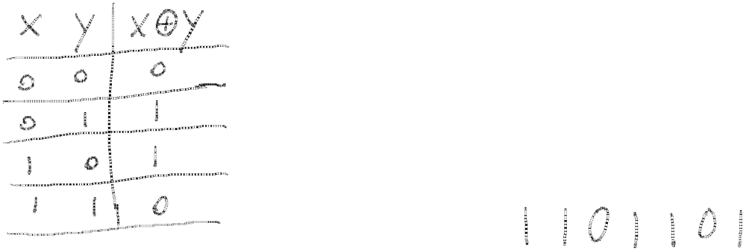
Review: XOR
XOR of two strings in {0,1}^{n} is their bit-wise addition mod 2
X | Y | X XOR Y
0 | 0 | 0
0 | 1 | 1
1 | 0 | 1
1 | 1 | 0
0 1 1 0 1 1 1
1 0 1 1 0 1 0
⊕
Notes:
XOR is addition mod 2. Write truth table.

Slide 12
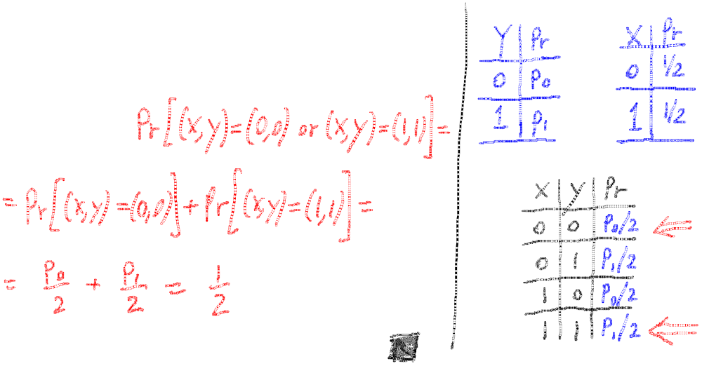
An important property of XOR
Thm: Y a rand. var. over {0,1}^{n} , X an indep. uniform var. on {0,1}^{n}
Then Z := Y⨁X is uniform var. on {0,1}^{n}
Proof: (for n=1)
Pr[ Z=0 ] = Pr[ (x,y) = (0,0) or (x,y) = (1,1)]
= Pr[ (x,y) = (0,0)] + Pr[(x,y) = (1,1)]
=1/2
Y | Pr
0 | P0
1 | P1
Y | Pr
0 | 1/2
1 | 1/2
X | Y | X XOR Y
0 | 0 | P0/2
0 | 1 | P1/2
1 | 0 | P0/2
1 | 1 | P1/2

Slide 13
The birthday paradox
Let r₁, …, r_{n} ∈ U be indep. identically distributed random vars.
Thm: when n= 1.2 × |U|^{1/2} then Pr[ ∃i≠j: r_{i} = r_{j} ] ≥ ½
Example: Let U = {0,1}¹²⁸
After sampling about 2⁶⁴ random messages from U,
some two sampled messages will likely be the same
notation: |U| is the size of U

Slide 14
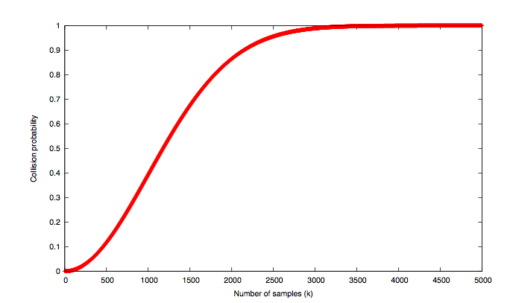
|U|=10⁶
collision probability
# samples n

